Slide 1
Student volunteers’ perspectives on the Rural Secondary School Visits program and its’ perceived effectiveness on rural medicine, nursing and allied health student recruitment
Kurtis Gray

Slide 2
Acknowledgement of Country
The National Rural Health Student Network would like to acknowledge the Traditional Custodians of the lands on which we meet today and pay respects to their Elders past and present and extend that respect to all Aboriginal and Torres Strait Islander peoples today

Slide 3
MSOD Data
“2020 data showed that respondents who reported being members of rural clubs were 3.6 times more likely to express a preference to practice outside of capital cities than those who were not members”.
“2021 data showed that respondents who reported being members of rural clubs were 4.4 times more likely to express a preference to practice outside of capital cities than those who were not members”.

Slide 4
Rural Health Clubs
There are 29 RHCs across Australia
Each RHC functions slightly differently depending on their local environments e.g. University involvement
The one consistency across all RHCs is that they are required to do 2 Rural Secondary School Visits per calendar year to receive funding
Notes:
I would add 'student' quotes

Slide 5
Rural Secondary School Visits
Involve students who are members of their RHC visiting rural high schools
Inspiring secondary school students to become healthcare workers and informing them on how to achieve this.
Rural students are more likely to become rural clinicians

Slide 6
Aims
To hear the student volunteers perspectives on the effectiveness of the program
To find out the impact these visits have on our student volunteers likelihood to practice rurally
Is there any significant difference between rural and metro students?
Notes:
Can you provide the impact of financial stress while on their placement? In my data I do.

Slide 7
Rural Secondary School Visits
A digital survey (Qualtrics) will be distributed to volunteers in the RSSV program across the NRHSN
Data will be qualitative and quantitative
This survey is allowed to be filled out once per RSSV
Data collection will remain open between May - August

Slide 8
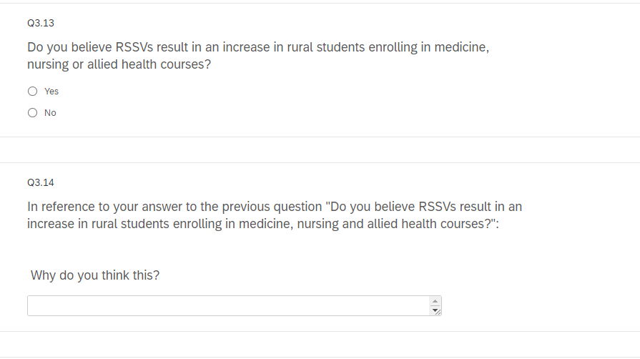
Aim 1: Perspectives

Slide 9
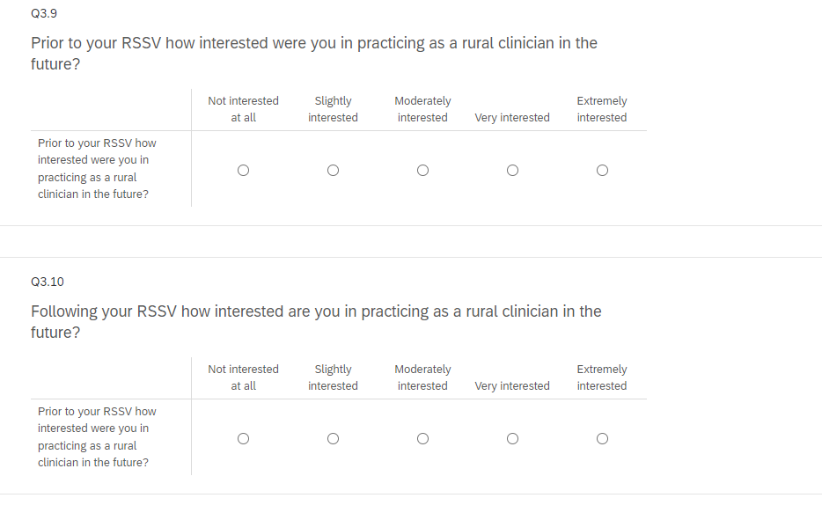
Aim 2: Impact

Slide 10
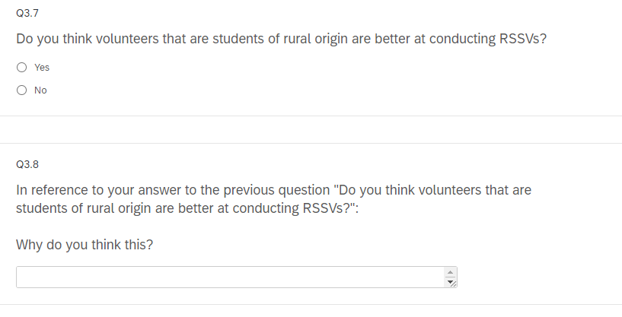
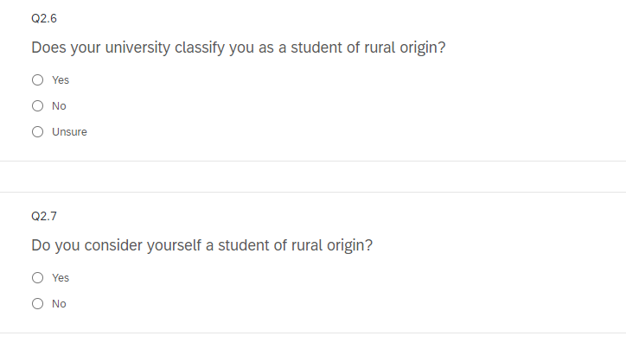
Aim 3: Rural vs Metro Students

