Slide 1
Addressing the Financial Barriers to a Successful Rural Placement
Kurtis Gray and Anna Ryan
Notes:
Today we will be presenting on behalf of NRHSN, my name is Anna and as chair of the NRHSN I am joined by Kurtis, the NRHSN vice hair external
Thank you to FRAME for inviting us to speak at this symposium – as a student network, we are appreciative of the opportunity to have a voice at the future regional and remte workforce table!
Also thankyou to my Vice Chair External, Kurtis for leading the development of this project

Slide 2
Acknowledgement of Country
The National Rural Health Student Network would like to acknowledge the Traditional Custodians of the lands on which we meet today, and pay respects to their Elders past and present and extend that respect to all Aboriginal and Torres Strait Islander peoples today
Notes:
I would like to acknowledge the traditional custodians of the Wiradjuri and Wadjuk-Noongar lands from which we have travelled, in addition to acknowledging the lands on which we meet today. I would like to pay my respects to elders past and present and extend that respect to all Aboriginal and Torres Strait Islander people here today.

Slide 3
What is the NRHSN?
The NRHSN is a multi-disciplinary health club network comprising 29 Rural Health Clubs (RHCs) across all states and territories in Australia
The NRHSN is an initiative of the Australian Government Department of Health administered as a consortium by the Rural Workforce Agency (RWA)
Notes:
Adding to the theme of today, the interplay between health and education in rural, regional and remote communities,
a great initiative run by clubs and supported by NRHSN is rural high school visits – university students undertake outreach workshops to rural schools and provide opportunities for school students to learn more about health degrees on offer. You can’t be what you can’t see.
Medical Students Outcome Database show students part of RHCs are 4x more likely to return rurally – starting this from grassroots in early highschool

Slide 4
2
4
4
3
11
4
1

Slide 5
Background
In 2023 the NRHSN conducted an internal audit focusing on the financial barriers to a rural placement
All students who had been on a rural placement were allowed to fill out the survey once per placement
The survey was distributed via social media and email
Data was collected by google forms and de-identified

Slide 6
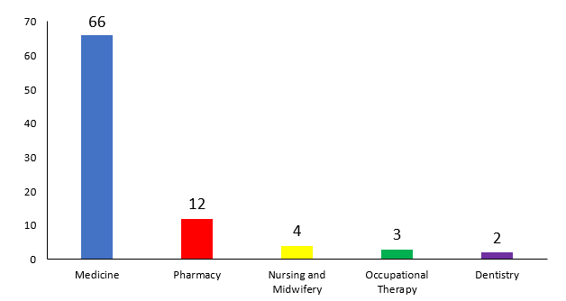
Demographics (n=87)

Slide 7
Financial Stress
62% of students reported feeling financial stress while on their placement
84% of students did not know where to find support if they were experiencing financial hardship
40% of students were ineligible for Centrelink

Slide 8
Ineligibility for Centrelink
Centrelink has 2 key programs for students
Youth Allowance (18-24)
Austudy (25+)
Youth Allowance is what most undergraduates would qualify for...

Slide 9
Youth Allowance eligibility
Must fulfil one of the following criteria (18-21)
Are in a situation where it is unreasonable for them to live at home
Have parents who can't look after them
Are in state care, including foster care
Are a refugee whose parents don't live in Australia
Are an orphan
Have worked at least 30 hours per week for 12 months, not be living at home and not be receiving financial support from parents

Slide 10
Youth Allowance eligibility
Can also apply based on low income
Any household where the parents and applicant earn more than a combined $60,000 are ineligible
40% of students surveyed being ineligible for Youth Allowance is an issue that requires a solution

Slide 11
Additional Stats
Only 50% of students were aware of scholarships available for rural placements at their university
Only 31% of students were aware of scholarships from external organisations e.g. RACGP
65% of students are not applying for financial scholarships or stipends
Of those that are successful 40% of the stipends are less than $500

Slide 12
Financial Barriers - Quotes
“I had to travel back and forth from my hometown in order to work because of the financial stress going rural applied to my life”
“Although accommodation was only $100/week, we still were paying rent for out accommodation in the town we attend university”
“Having a part time job would have been almost impossible due to long placement hours”

Slide 13
Financial Barriers - Quotes
“Due to my family situation, I was ineligible for the one scholarship that was advertised….There was no Wi-Fi to do my research project or drinkable water provided (we had to buy from the supermarket). None of this was told to me before the placement”
“...I really felt for the other student on my placement who doesn’t get Centrelink”

Slide 14
Financial Stress – A reminder
62% of students reported feeling financial stress while on their placement
84% of students did not know where to find support if they were experiencing financial hardship
40% of students were ineligible for Centrelink

Slide 15
Solution: Expansion of OS-HELP Loans and Overseas Study Program
The OS-HELP Loans and Overseas Study program is an initiative to mitigate the financial barriers to international placements
This program allows the student to take a loan of $7,348 (2023) though their HECS debt to fund their international study e.g. medical students and Electives
Increases to more than $8,000 if they choose to study in Asia
Solution to many financial issues with placements: Expand the program to include rural and remote placements

Slide 16
OS HELP Rural and Remote - Benefits
Not have to work during their placements
Provide financial support to students who are ineligible for Centrelink
Provide emergency financial support for students during a crisis

Slide 17
NRHSN Advocacy Work
The data you have seen today will be written up and presented as a proposal
40% of students are ineligible for Centrelink
62% of students experiencing financial stress
Lack of awareness around scholarships
The expansion of the OS-HELP Loans and Overseas Study program to include rural and remote placements
More rural placements = more rural clinicians = expansion of the future rural workforce
If any organisations would like to read or support our proposal, please let us know

Slide 18
Kurtis Gray and Anna Ryan

